Slide 1
Health Index Creation
DESCRIPTIVE & INFERENTIAL STATISTICS

Slide 2
Statistics is the branch of mathematics that helps us spot trends and patterns in the bulk of numerical data. Statistical techniques can be categorized as Descriptive Statistics and Inferential Statistics
Descriptive and Inferential Statistics
Statistics
To predict about a large data based on sample
Describe and summarize data;
Stating facts
Descriptive Statistics
Inferential Statistics
Measures of central tendency
Measures of variability
Frequency
distribution
Hypothesis testing
Regression and correlation analysis
Confidence Intervals
Mean
Median
Mode
Range
Variance
Std Dev
Skewness
Kurtosis
IQR
MAD
Histogram
Bar chart
Line chart
Pie chart
Freq table of count/percentage

Slide 3
Health Index Creation
DESCRIPTIVE STATISTICS

Slide 4
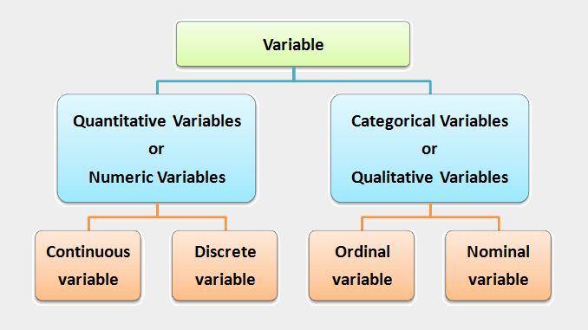
Types of Variables
Weight : 40, 52.5, 63.2, 74.1, 95.7
# of children: 0, 1, 2, 3, 4, 5
Feedback: very bad, bad, average, good, very good
Gender: Male, Female
Types of Data
Structured Data: Data that is organized and fits tidily into spreadsheets and relational databases
Ex: Numeric data
Unstructured Data: Data that is either does not have a pre-defined schema and therefore cannot be stored in a traditional relational database or RDBMS
Ex: email messages, videos, photos, webpages, and audio files.

Slide 5
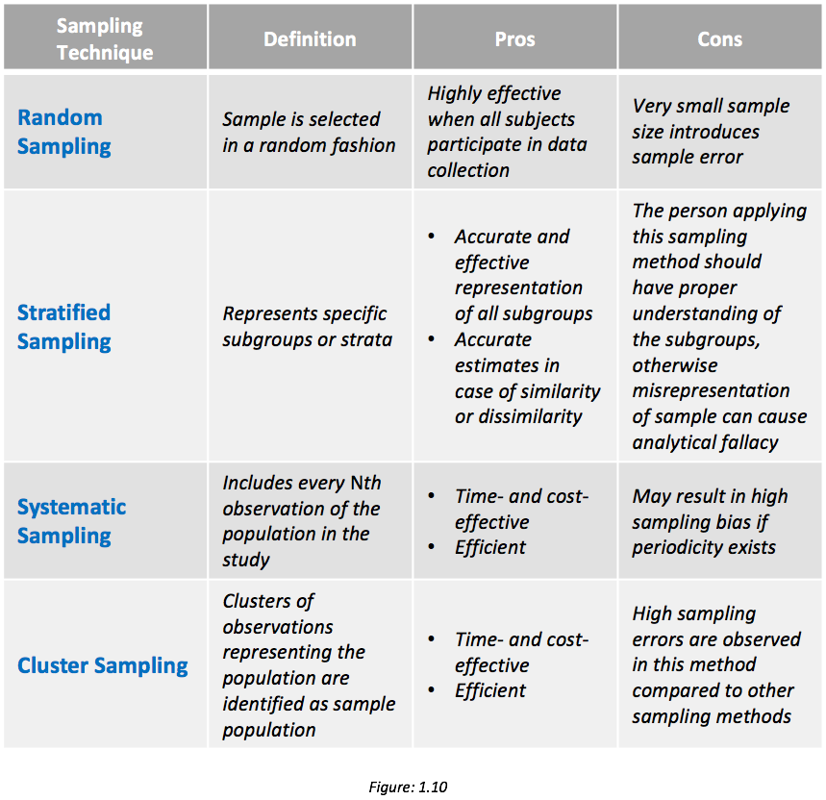
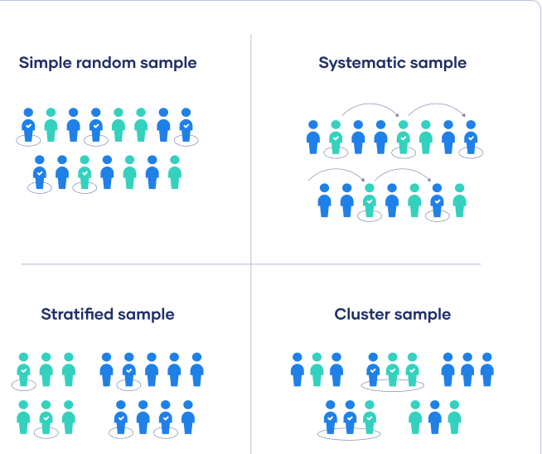
Sampling Methods
Sampling is a process of selecting a predetermined number of observations from a larger population
Notes:
divide the entire population into sections or clusters that represent a population.
choose the sample members of a population at regular intervals
Cluster sampling is a probability sampling method in which you divide a population into clusters, such as districts or schools, and then randomly select some of these clusters as your sample

Slide 6
Measures of Central Tendency : Mean
Talks about which values are “in the middle” or “popular” in the data
Sensitive to extreme values so Influenced by outliers
Example: sales of a product in a week 20, 25, 25, 30, 35, 40, 42
Total Sales = 217
Mean = 31
If there is an unexpected demand on Sunday : 20, 25, 25, 30, 35, 40, 420
Total Sales = 595
Mean = 85

Slide 7
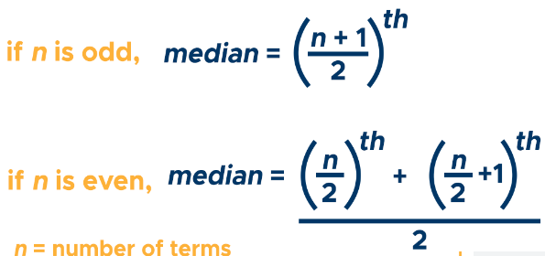

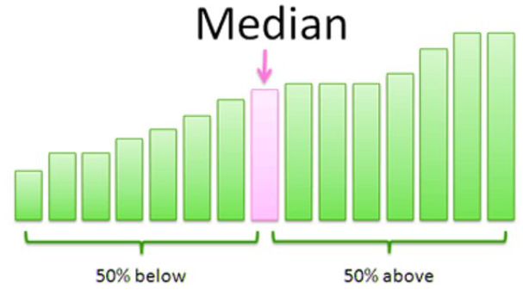
Measures of Central Tendency : Median & Mode
Best suited when data is in ordinal or interval scale
Example: sales of a product in a week 20, 25, 30, 25, 35, 40, 42;
Sorted: 20, 25, 25, 30, 35, 40, 42
Median = 30
If there is an unexpected demand on Sunday : 20, 25, 30, 25, 35, 40, 420
Sorted: 20, 25, 25, 30, 35, 40, 420
Median = 30
Best suited when data is in nominal scale
Example: sales of a product in a week 20, 25, 30, 25, 35, 40, 42
Mode = 25
If there is an unexpected demand on Sunday : 20, 25, 30, 25, 35, 40, 420
Mode = 25

Slide 8
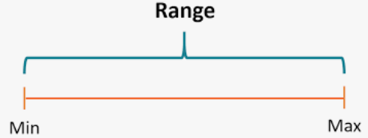
Measures of Dispersion: Range
Dispersion: Explains how “spread out” is the data? How “far” away from the mean or median do the observed values tend to be?
Range is the difference between the largest and smallest values
Range = Maximum – Minimum
It is not robust as it is influenced by outliers
Example: sales of a product in a week 20, 25, 30, 25, 35, 40, 42
Range = 22
If there is an unexpected demand on Sunday : 20, 25, 30, 25, 35, 40, 420
Range = 400

Slide 9
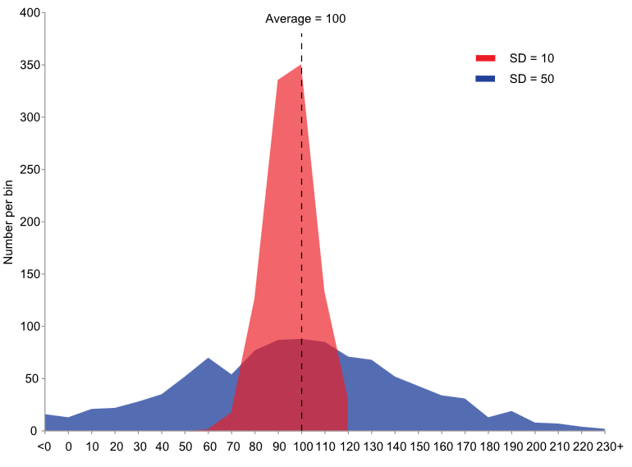
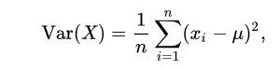
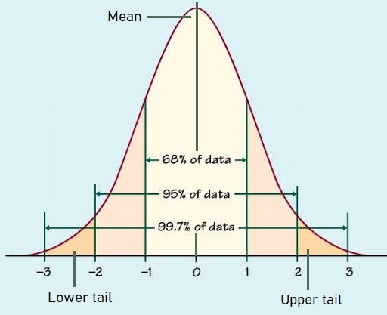
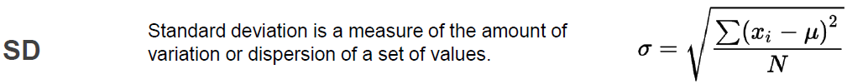
Measures of Dispersion: Variance and Standard Deviation
Variance is an indication of how far a set of values are spread out from its average
Low
Variance
It’s completely uninterpretable because it doesn’t use the same units as the data
Ex: 20, 25, 30, 25, 35, 40, 42; Variance = 58.8
Ex: 20, 25, 30, 25, 35, 40, 420; Variance = 18742.8
Standard Deviation: square root of variance
Both measures reflect variability in a distribution, but their units differ
High
Variance
Ex: 20, 25, 30, 25, 35, 40, 42; SD = 7.6
Ex: 20, 25, 30, 25, 35, 40, 420; SD = 136.9

Slide 10
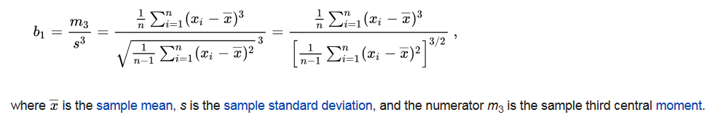
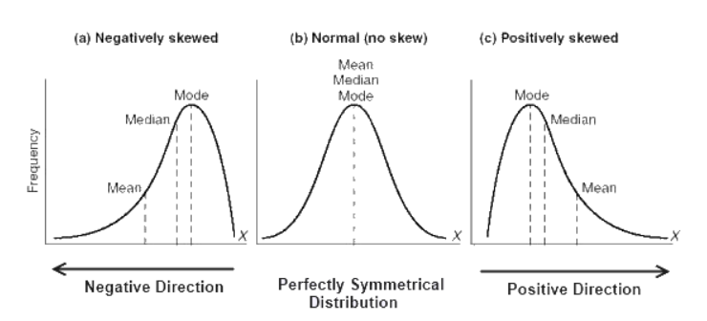
Measures of Dispersion: Skewness
Skewness is a measure of the asymmetry of the probability distribution about its mean.
Skewness Formula

Slide 11
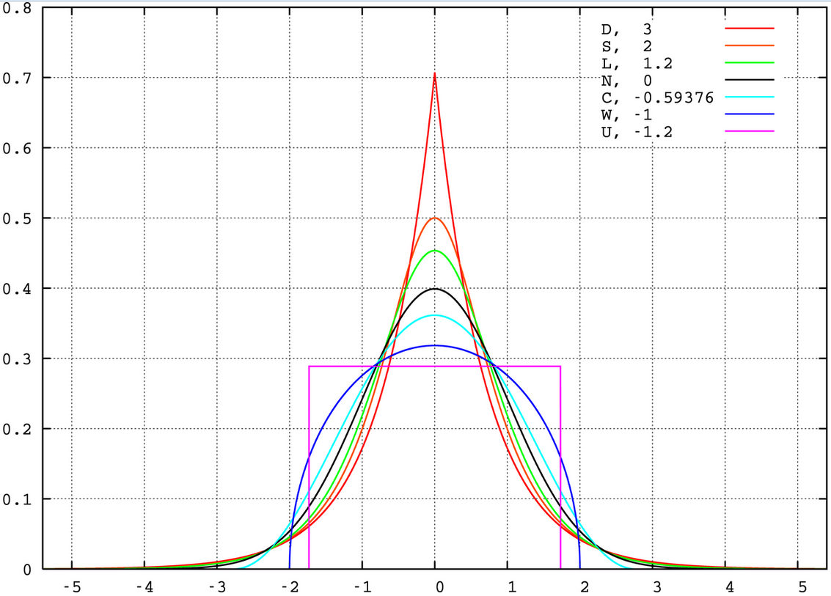
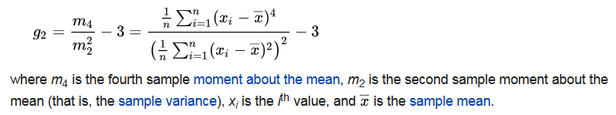
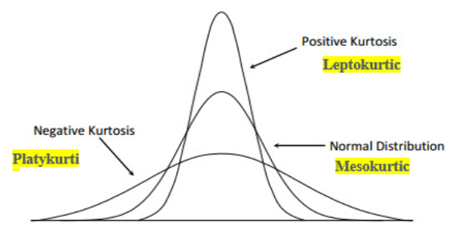
Measures of Dispersion: Kurtosis
Kurtosis is a measure of the “tailedness” of the probability distribution.
Is the data heavy-tailed or light-tailed relative to a normal distribution. how much data is in the tails of a distribution v.s. the center
Kurtosis Formula

Slide 12
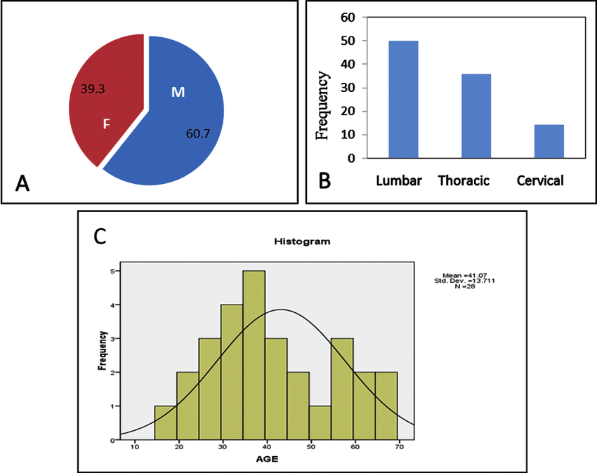
Frequency Distribution
Frequency distributions are portrayed as frequency tables or charts. Frequency distributions can show either the actual number of observations falling in each range or the percentage of observations

Slide 13
Python Exercise

Slide 14
Probability

Slide 15
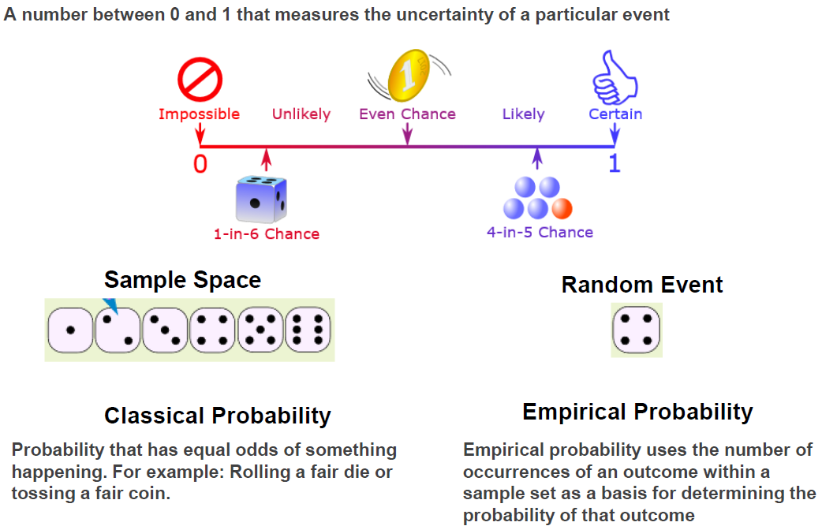
Introduction to Probability
Probability is the study of chance. It is measured by the ratio of the favorable cases to the whole number of cases possible

Slide 16
Event Types
Notes:
The difference between mutually exclusive and independent events is: a mutually exclusive event can simply be defined as a situation when two events cannot occur at same time whereas independent event occurs when one event remains unaffected by the occurrence of the other event.

Slide 17
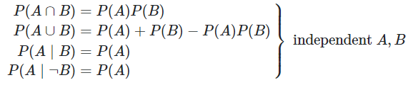
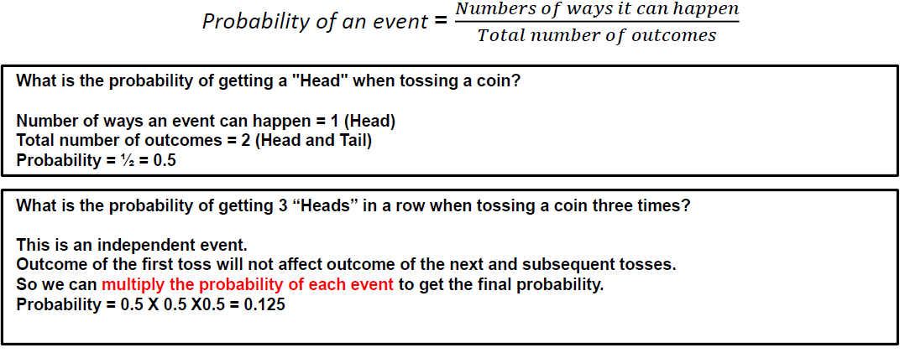
Independent Events
Independent event :- The occurrence of one event does not affect the occurrence of the others e.g if we flip a coin two times, the first time may show a head, but this does not guarantee that the next time when we flip the coin the outcome will also be heads

Slide 18
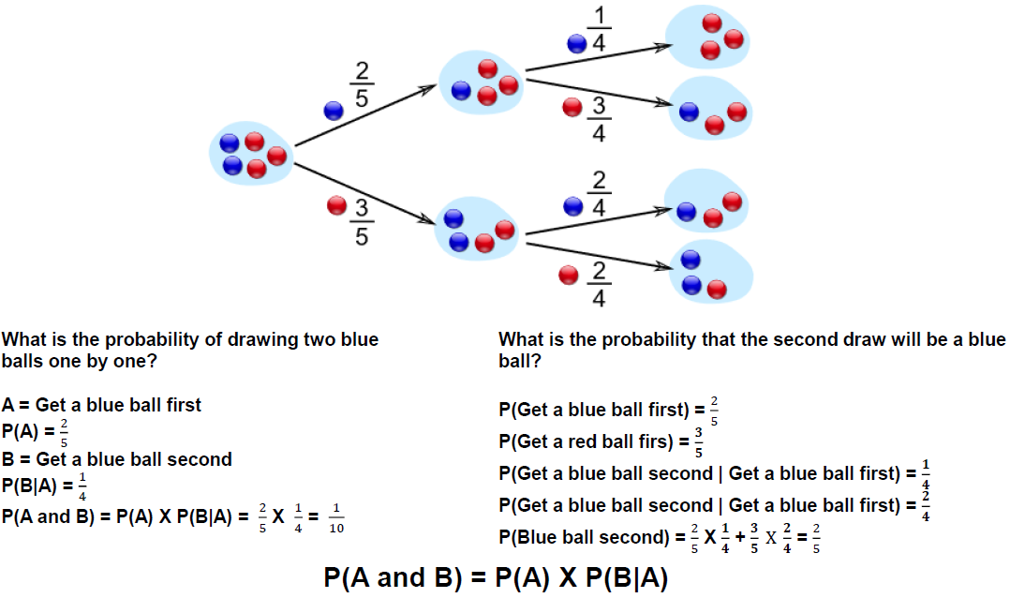
Dependent Events
Two events are said to be Dependent when the outcome of the first event influences the outcome of the second event.
2 blue and 3 red marbles are in a bag.
Without Replacement: the events are Dependent (the chances change)
With Replacement: the events are Independent (the chances don't change)

Slide 19
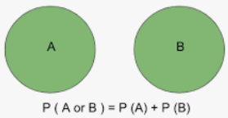
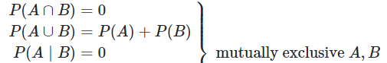
Mutually Exclusive Events
Mutually exclusive event :- two events are mutually exclusive event when they cannot occur at the same time. e.g if we flip a coin it can only show a head OR a tail, not both.
When tossing a coin, the event of getting head and tail are mutually exclusive. Because the probability of getting head and tail simultaneously is 0
In a six-sided die, the events “2” and “5” are mutually exclusive. We cannot get both the events 2 and 5 at the same time when we threw one die.
In a deck of 52 cards, drawing a red card and drawing a club are mutually exclusive events because all the clubs are black
The probability of a King and a Queen is 0 (Impossible); A card cannot be a King AND a Queen at the same time

Slide 20
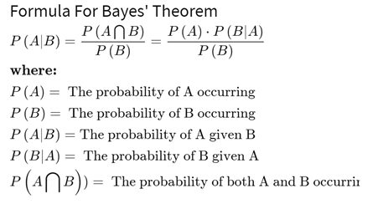
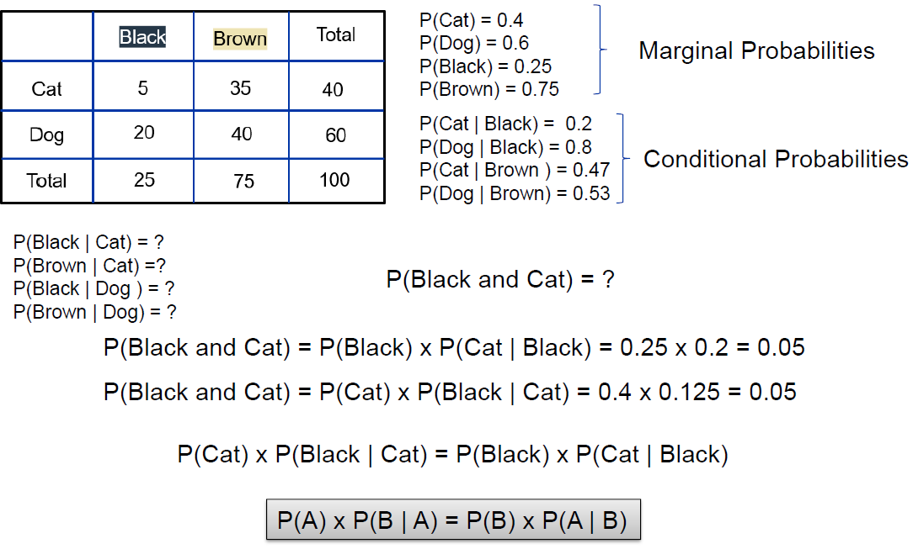
Bayes Theorem
Describes the probability of an event, based on prior knowledge of conditions that might be related to the event
Prior
Marginal
Posterior
Likelihood

Slide 21
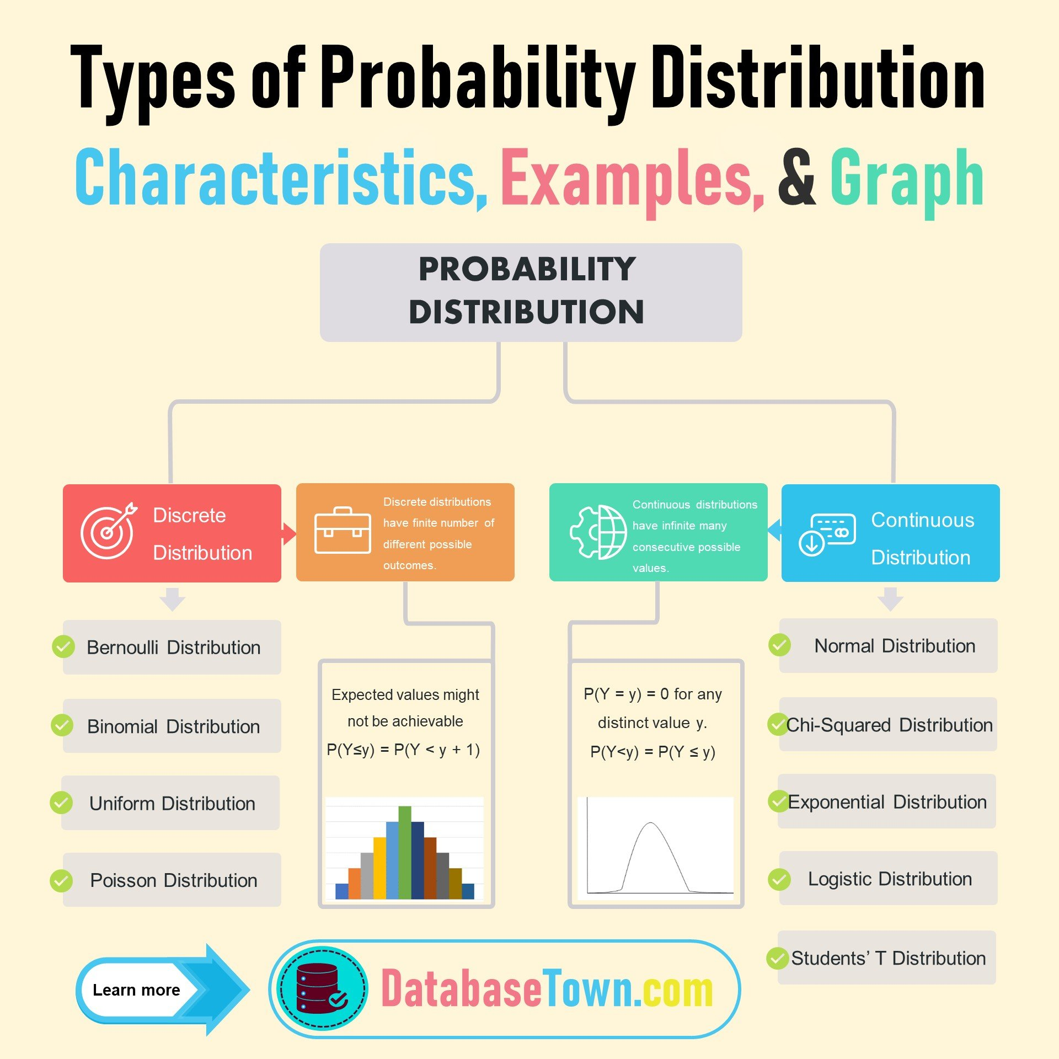
Probability Distribution
A probability distribution is a statistical function that describes the likelihood of obtaining all possible values that a random variable can take Discrete distribution describes the probability of occurrence of each value of a discrete random variable. A discrete random variable is a random variable that has countable values, such as a list of non-negative integers
Probability mass function of a discrete random variable X assigns probabilities to the possible values of the random variable
Continuous distribution describes the probabilities of the possible values of a continuous random variable. A continuous random variable is a random variable with a set of possible values (known as the range) that is infinite and uncountable. Probabilities of continuous random variables (X) are defined as the area under the curve of its PDF
Notes:
Cumulative distribution function probability that a random variable is less than or equal to a specific value

Slide 22
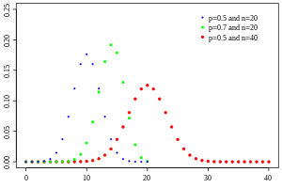
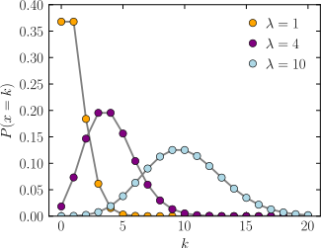


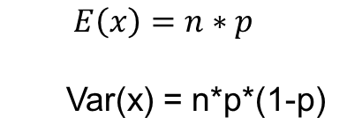
Discrete Distributions
Binomial: Probability of number of successes ( j ) in a sequence of n independent experiments
Applies to process that has two outcomes. Head vs. Tail, success vs. failure, fault vs. no-fault
Number of attempts = n
Number of success = j
Probability of success is = p
Probability of failure = 1-p
Poisson: Probability of a given number of events (k) occurring
in a fixed interval of time or space
Ex: Rate of arrival of messages, failure on an airplane
P(x=j) = $\frac{n!}{\left(n−j\right)!∗j!} ∗p^{i}∗{(1−p)}^{n−i}$
$$E\left(x\right)=n∗p$$
Var(x) = n*p*(1-p)
Probability mass function
Notes:
Cumulative distribution function probability that a random variable is less than or equal to a specific value

Slide 23
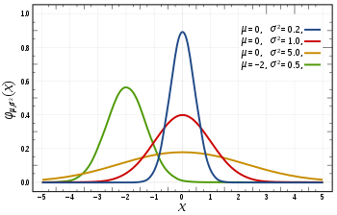
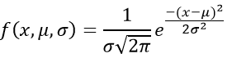
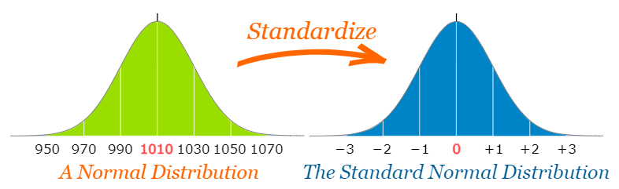
Continuous Distribution: Normal Distribution (Bell Curve)
Normal distribution (Gaussian distribution) is a probability distribution that is symmetric about the mean, showing that data near the mean are more frequent in occurrence than data far from the mean
It is defined by the probability density function for a continuous random variable in a system
​"A" normal distribution is used to describe a normal distribution with any mean and standard deviation
"The" standard normal distribution is used to describe one specific normal distribution (mean = 0, standard dev = 1) .
Notes:
Cumulative distribution function probability that a random variable is less than or equal to a specific value

Slide 24
Inferential Statistics

Slide 25
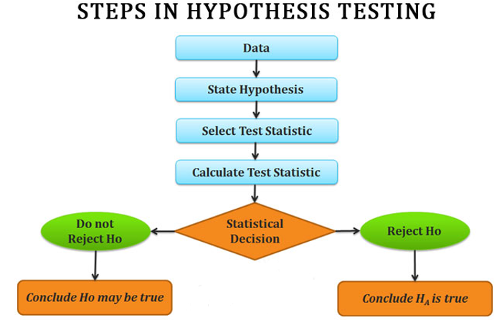
Hypothesis Testing
Statistical hypothesis testing is a framework for determining whether observed data deviates from what is expected. Hypothesis tests use sample data to answer research questions.
Significance level(α): is a probability threshold that determines when you reject the null hypothesis
Notes:
For example, you might be interested in knowing if a new cancer drug is effective. Or if breakfast helps children perform better in schools.
A hypothesis test evaluates two mutually exclusive statements about a population to determine which statement is best supported by the sample data
There are 5 main steps in hypothesis testing:
State your research hypothesis as a null hypothesis and alternate hypothesis (Ho) and (Ha or H1).
A coin is fair
No treatment/repair is more effective than another
Collect sample data in a way designed to test the hypothesis.
Set the Significance or confidence level (95%) and Perform an appropriate statistical test.
Decide whether to reject or fail to reject your null hypothesis.
Present the findings in your results and discussion section.
Confirming or denying the likelihood of a conclusion or an explanation made on the basis of limited evidence
Alpha is the probability that the event could have occurred by chance
p-value : The probability of seeing a result as extreme as the one observed due to chance (under the assumption that the H0 is correct)
p-value < alpha: reject the null hypothesis in favor of the alternative.
T-test is a statistical test used to determine whether a sample mean differs from the population mean or whether two samples differ from one another.
A one-sample t-test checks whether a sample mean differs from the population mean.
A two-sample t-test investigates whether the means of two independent samples differ from one another.
A paired t-test lets you check whether the means of samples from the same group differ
Type I error (α) describes a situation where you reject the null hypothesis when it is actually true. This type of error is also known as a "false positive" or "false hit". The type 1 error rate is equal to the significance level α, so setting a higher confidence level (and therefore lower alpha) reduces the chances of getting a false positive.
Type II error describes a situation where you fail to reject the null hypothesis when it is actually false. Type II error is also known as a "false negative" or "miss". The higher your confidence level, the more likely you are to make a type II error.
The power of a statistical test is the probability that the test rejects the null hypothesis when the alternative is actually different from the null. In other words, power is the probability that the test detects that there is something interesting going on when there actually is something interesting going on. Power is equal to one minus the type II error rate.
Z Test : use it instead of t-test if sample size > 30
ANOVA (F-TEST): To compare more than two groups at the same time
Chi-Square Test: To determine whether there is a significant association between the two categorical variables

Slide 26
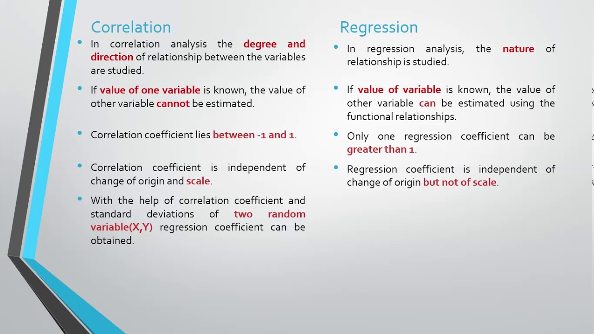
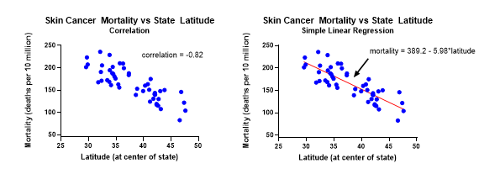
Regression and Correlation Analysis
Correlation quantifies the strength of the linear relationship between a pair of variables
Regression expresses the relationship in the form of an equation
Notes:
Variance is a measure of variability from the mean
Covariance is a measure of relationship between the variability of 2 variables - covariance is scale dependent because it is not standardized
Correlation is a of relationship between the variability of of 2 variables - correlation is standardized making it not scale dependent
(bxy​,byx​)

Slide 27

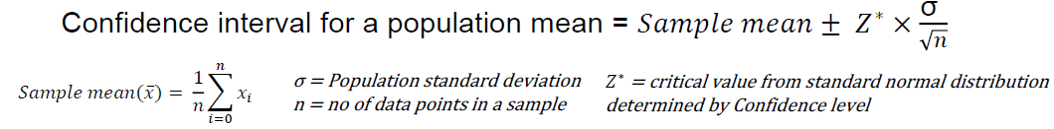
Confidence Interval
Confidence Interval is a range of values above and below a point estimate that captures the true population parameter at some predetermined confidence level. For example, if you want to have a 95% chance of capturing the true population parameter with a point estimate and a corresponding confidence interval, you'd set your confidence level to 95%. Higher confidence levels result in a wider confidence intervals.
Point estimates are estimates of population parameters based on sample data.
Estimating parameters. Taking a statistic from your sample data (for example the sample mean) and using it to say something about a population parameter (i.e. the population mean).
Central Limit Theorem states the distribution of many sample means, known as a sampling distribution, will be normally distributed. mean of the sampling distribution approaches the true population mean
Notes:
A margin of error tells you how many percentage points your results will differ from the real population value
Margin of error is based on your desired confidence level, the spread of the data and the size of your sample.

Slide 28
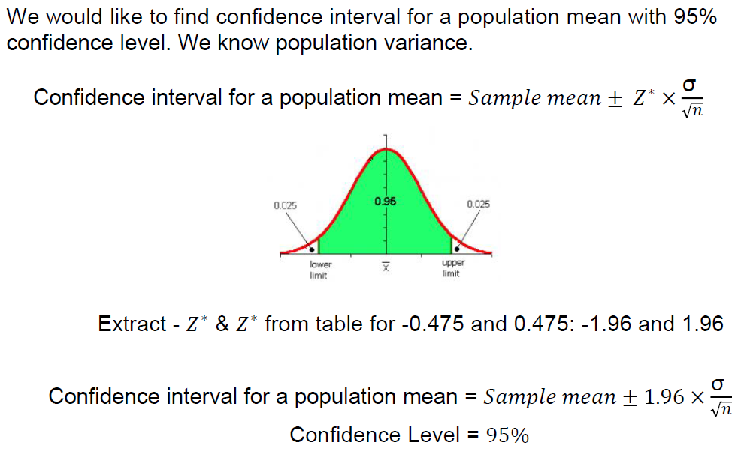
Confidence Interval Estimation with Normal Distribution

Slide 29
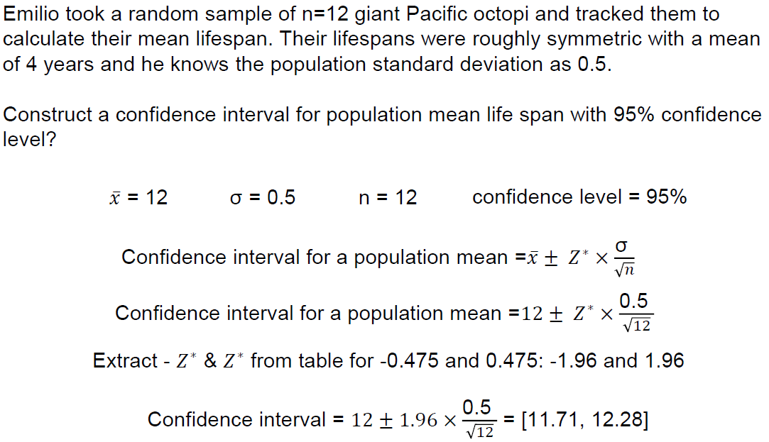
Confidence Interval Estimation with Normal Distribution: Example

Slide 30
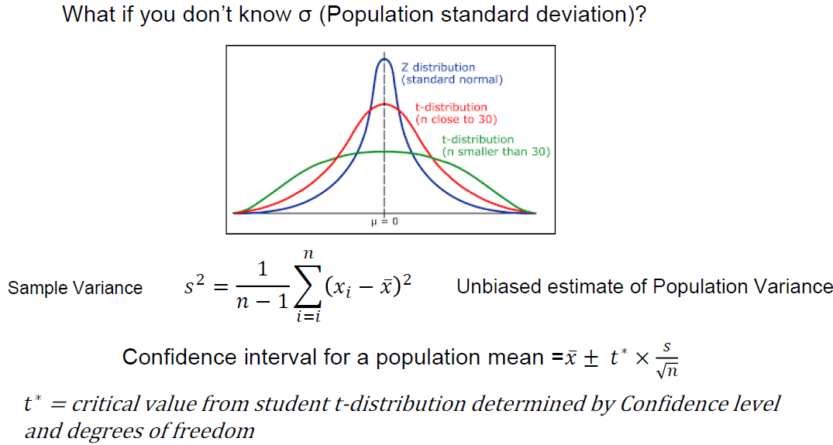
Confidence Interval Estimation with t-Distribution

Slide 31
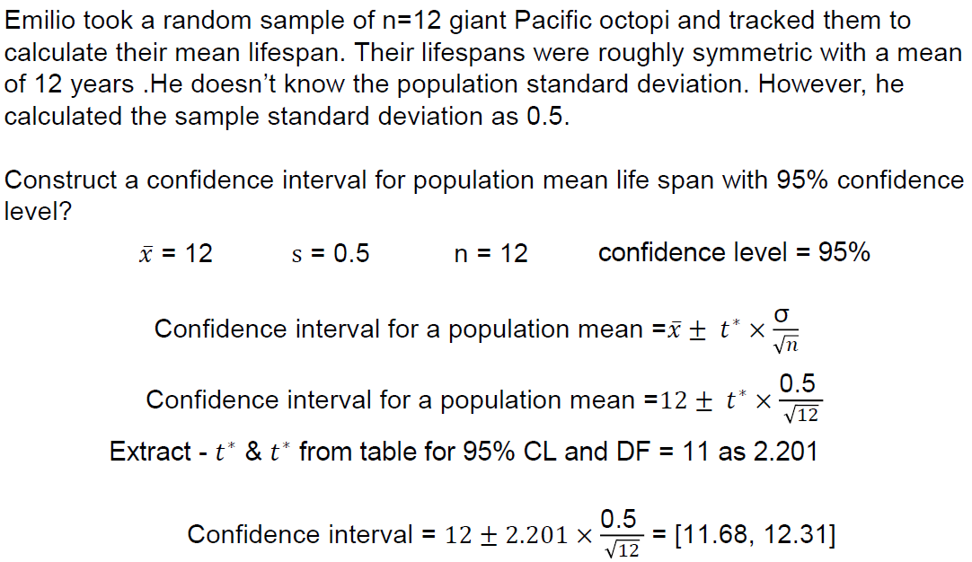
Confidence Interval Estimation with t-Distribution: Example

Slide 32
APPENDIX

Slide 33
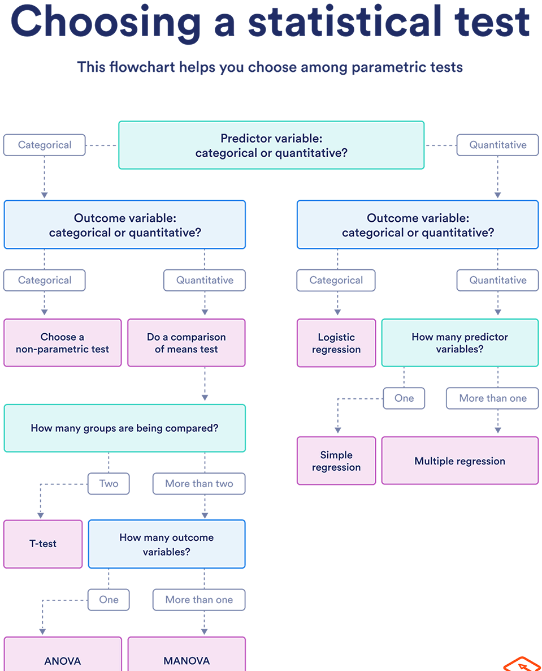

Slide 34
Hypothesis Testing
Statistical hypothesis testing is a framework for determining whether observed data deviates from what is expected
Confirming or denying the likelihood of a conclusion or an explanation made on the basis of limited evidence
Hypothesis tests use sample data to answer research questions. For example, you might be interested in knowing if a new cancer drug is effective. Or if breakfast helps children perform better in schools.
A hypothesis test evaluates two mutually exclusive statements about a population to determine which statement is best supported by the sample data
Significance level(α): is a probability threshold that determines when you reject the null hypothesis.
p-value : The probability of seeing a result as extreme as the one observed due to chance (under the assumption that the H0 is correct)
p-value < alpha: reject the null hypothesis in favor of the alternative.
T-test is a statistical test used to determine whether a sample mean differs from the population mean or whether two samples differ from one another.
A one-sample t-test checks whether a sample mean differs from the population mean.
A two-sample t-test investigates whether the means of two independent samples differ from one another.
A paired t-test lets you check whether the means of samples from the same group differ
Type I error (α) describes a situation where you reject the null hypothesis when it is actually true. This type of error is also known as a "false positive" or "false hit". The type 1 error rate is equal to the significance level α, so setting a higher confidence level (and therefore lower alpha) reduces the chances of getting a false positive.
Type II error describes a situation where you fail to reject the null hypothesis when it is actually false. Type II error is also known as a "false negative" or "miss". The higher your confidence level, the more likely you are to make a type II error.
The power of a statistical test is the probability that the test rejects the null hypothesis when the alternative is actually different from the null. In other words, power is the probability that the test detects that there is something interesting going on when there actually is something interesting going on. Power is equal to one minus the type II error rate.
Z Test : use it instead of t-test if sample size > 30
ANOVA (F-TEST): To compare more than two groups at the same time
Chi-Square Test: To determine whether there is a significant association between the two categorical variables
Notes:
Alpha is the probability that the event could have occurred by chance

